Slide 2
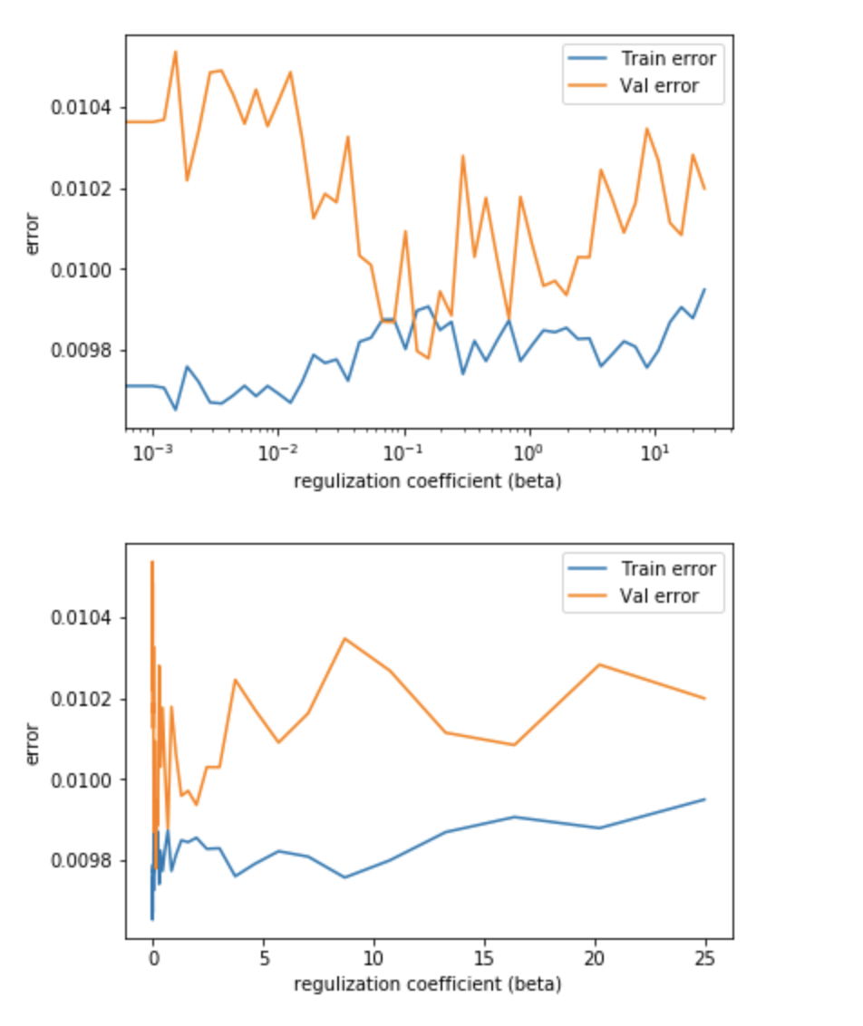
Run: 00:01:17; Left: 00:00:00 (Total: 00:01:17) The time cost is 00:01:17 The parameters are: beta_num = 10 epoch = 10 The values of beta with various regulation coefficients and different training samples are: [ 0.08396509 2.4551541 0.15811388 0.15811388 0.12804017 0.36767577 0.08396509 25. 1.0558051 0.69236683] The value of BETA should be 3.018319992054381

Slide 3
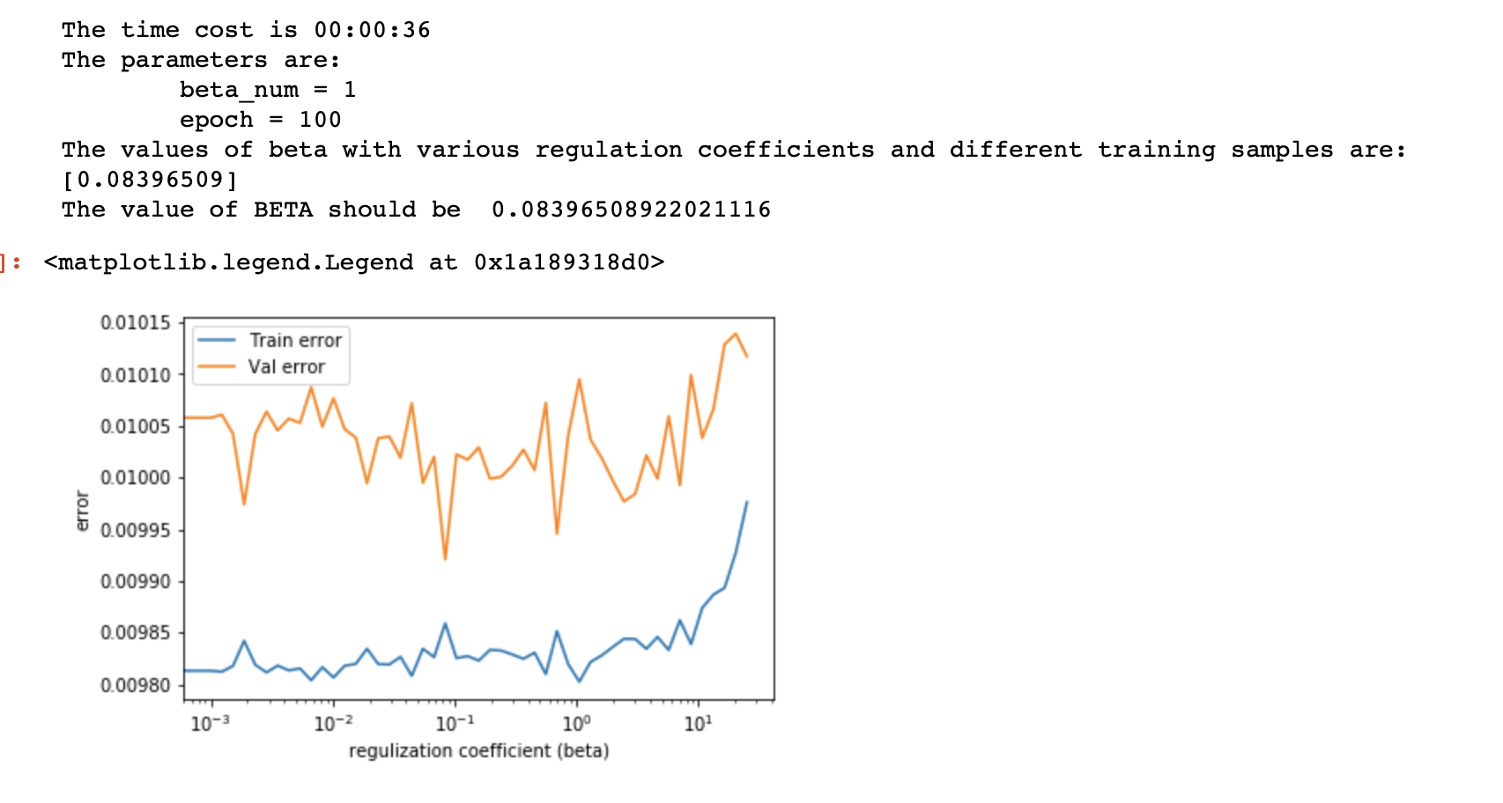
epoch =100

Slide 4
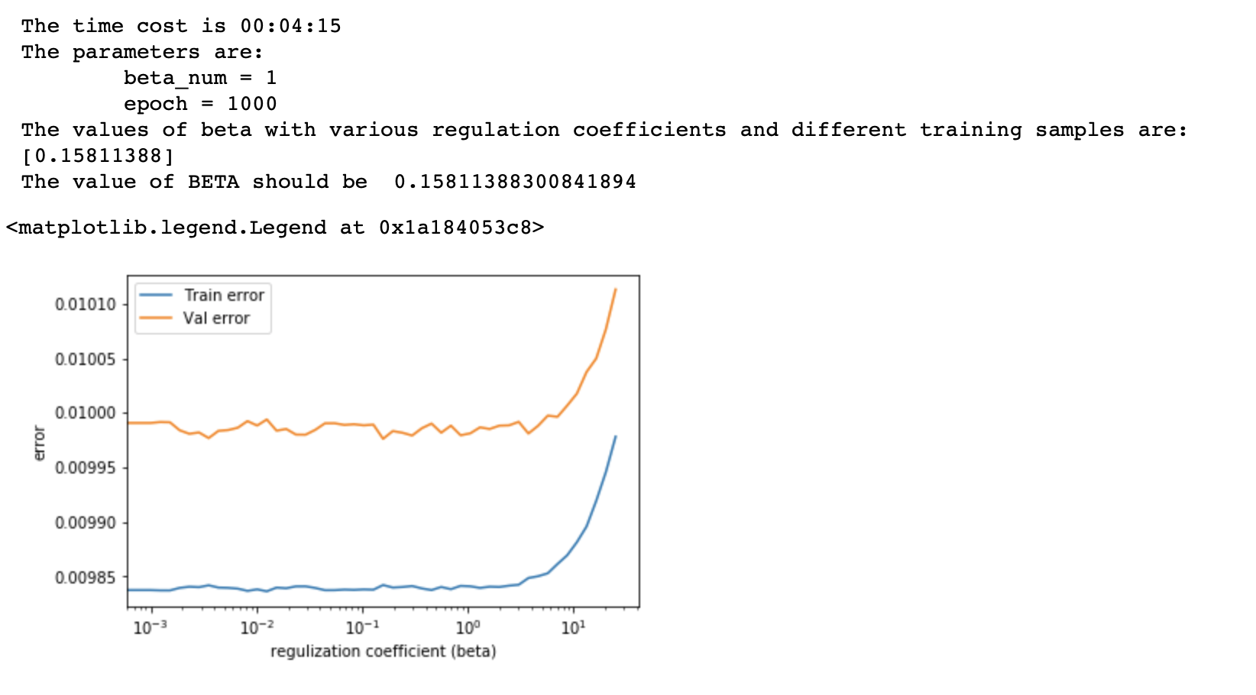
epoch = 1000

Slide 5
Mac: Multiprocess Vs Normal
感觉在循环小的时候multiprocess并不省时间，循环大的时候才省时间 loop >100
epoch =1000, mp is OFF, cpu is 4：
epoch =1000, mp is ON, cpu is 4：
epoch =10000, mp is OFF, cpu is 4：
epoch =10000, mp is ON, cpu is 4：

Slide 6
Workstation: Multiprocess Vs Normal
epoch =1000, mp is OFF, cpu is 4：
epoch =1000, mp is ON, cpu is 4：
epoch =10000, mp is ON, cpu is 4：
epoch =10000, mp is OFF, cpu is 4：

Slide 10
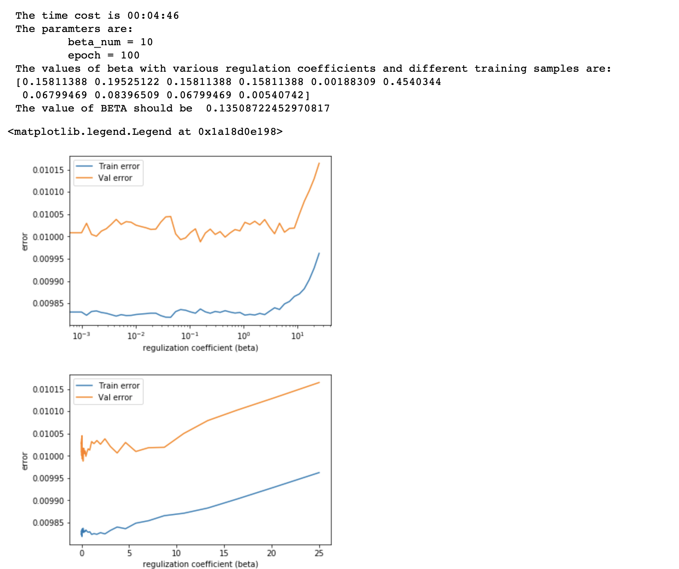

Slide 11
